Slide 1
Data and Signals

Slide 2
DATA & SIGNAL
like two building blocks of computer networks.
All the data transmitted over channel can either be in analog form or digital form.
Data are manipulated in the signal form suitable for the transmission channel.
Like data elements, signal can also either in analog form or digital form.
• Analog data converted into analog signal form, for example Telephone. • Digital data converted to analog signal form, for example modem. • Analog data converted to digital signal form, for example codec. • Digital data converted to digital signal form, for example digital transmitter.

Slide 3
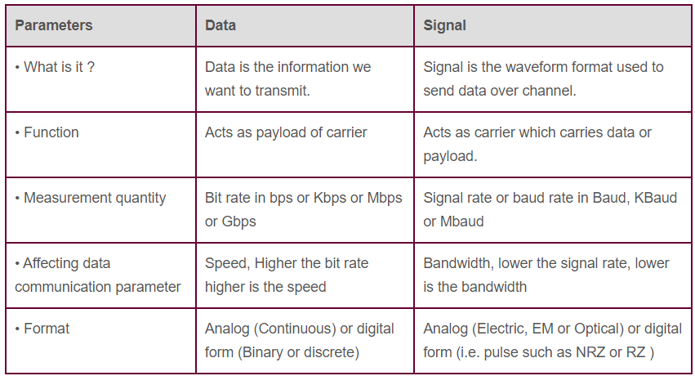
DATA vs SIGNAL

Slide 4
To be transmitted, data must be transformed to electromagnetic signals.

Slide 5
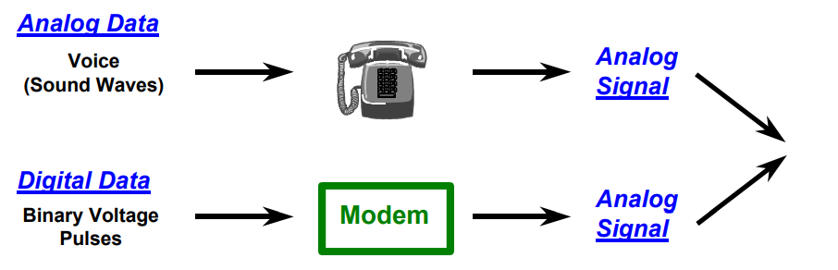
ANALOG AND DIGITAL DATA
Data can be analog or digital.
The term analog data refers to information that is continuous; digital data refers to information that has discrete states.
Analog data take on continuous values.
Digital data take on discrete values.

Slide 6
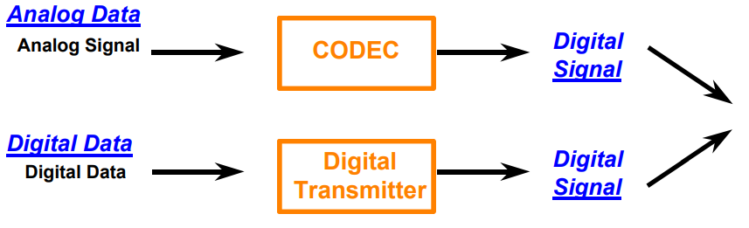
ANALOG AND DIGITAL DATA
Digital Signals - Data represented with a sequence of voltage pulses

Slide 7
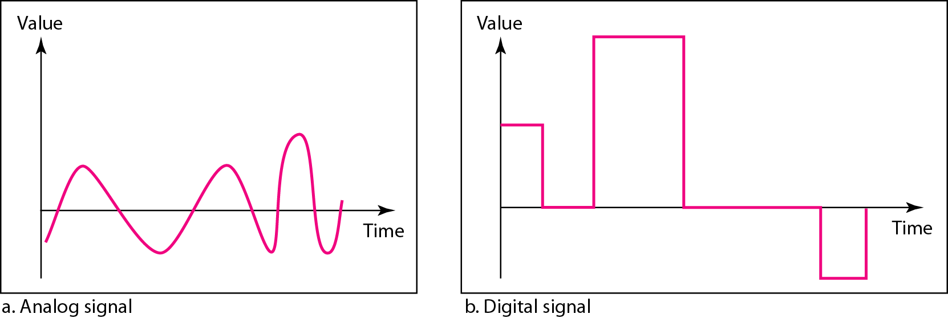
Analog and Digital Signals
Signals can be analog or digital.
Analog signals can have an infinite number of values in a range.
Digital signals can have only a limited number of values.
Comparison of analog and digital signals

Slide 8
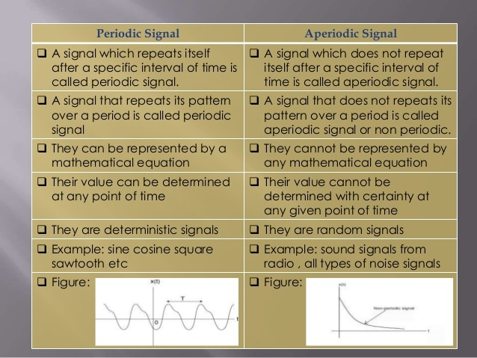
Periodic vs Non- Periodic Signals

Slide 9
PERIODIC ANALOG SIGNALS
In data communications, we commonly use periodic analog signals and non-periodic digital signals.
Periodic analog signals can be classified as simple or composite.
A simple periodic analog signal, a sine wave, cannot be decomposed into simpler signals.
A composite periodic analog signal is composed of multiple sine waves.
In addition to being represented by an analog signal, information can also be represented by a digital signal.
For example, a 1 can be encoded as a positive voltage and a 0 as zero voltage.
A digital signal can have more than two levels.
In this case, we can send more than 1 bit for each level.
DIGITAL SIGNALS

Slide 10
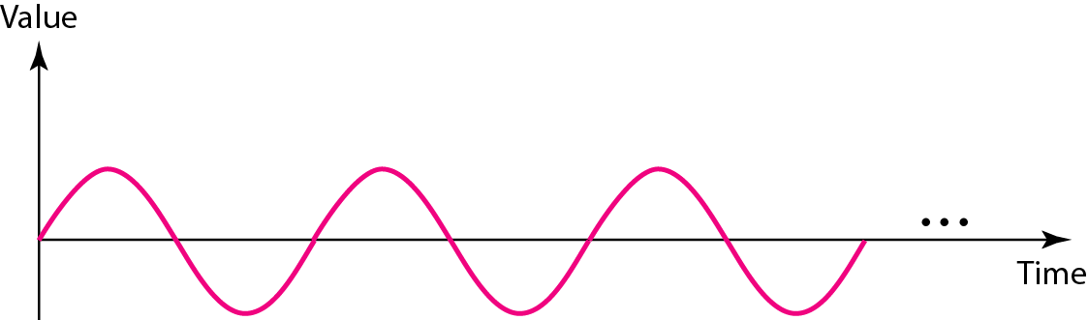
A sine wave
Simple periodic analog signal cannot be decomposed into simpler signals
Composite periodic analog signal is composed of multiple sine waves
Parameters:
Peak amplitude
Frequency
Phase

Slide 11
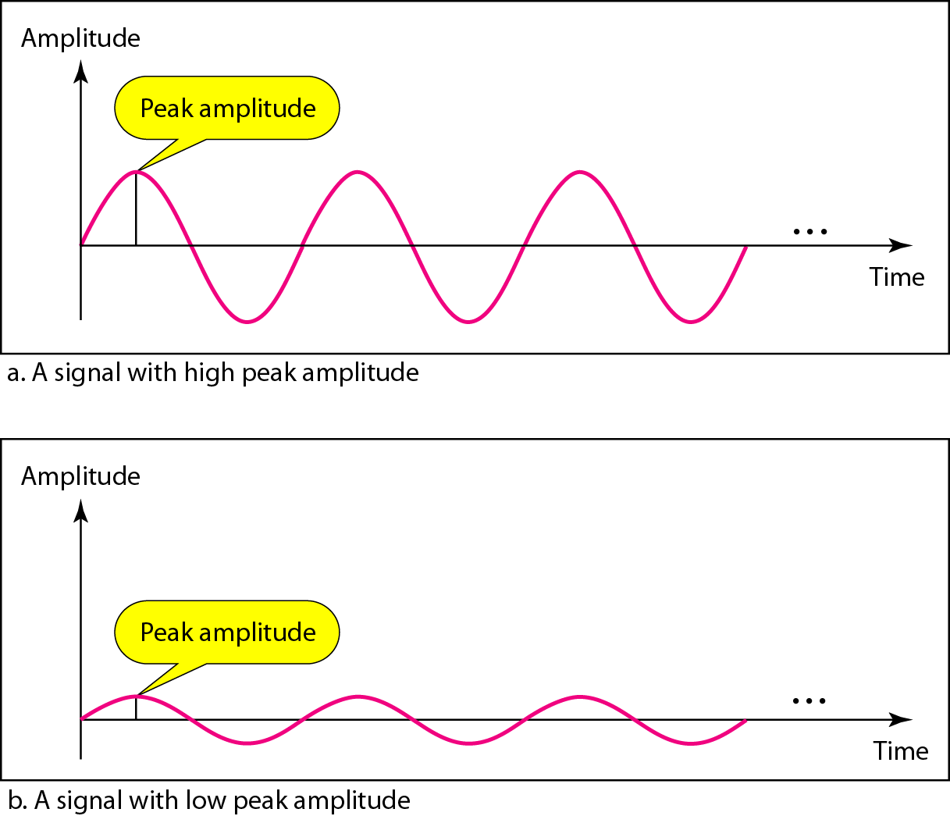
Two signals with the same phase and frequency, but different amplitudes
Peak amplitude of a signal is the absolute value of its highest intensity, proportional to energy it carries.

Slide 12

Period and Frequency
Period – amount of time (in secs) a signal needs to complete 1 cycle
Frequency refers to number of periods in 1 sec. (measured in Hz)
Frequency and period are the inverse of each other.

Slide 13
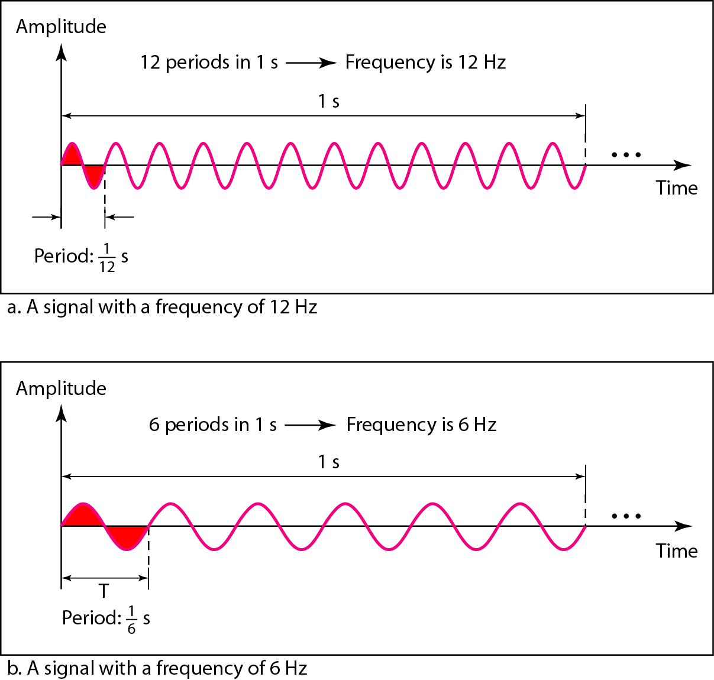
Two signals with the same amplitude and phase, but different frequencies

Slide 14
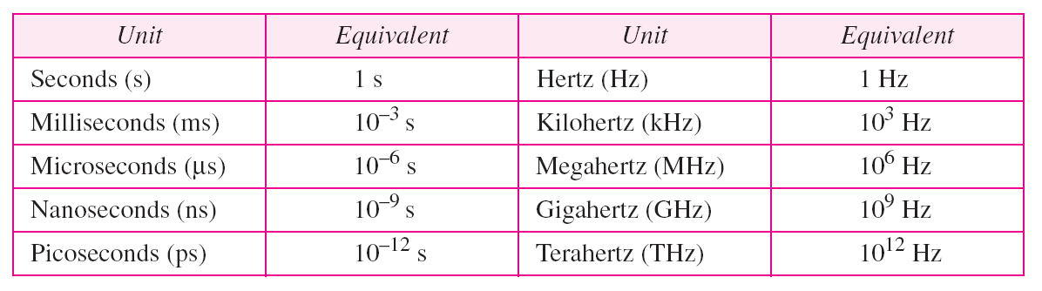
Units of period and frequency

Slide 15
Example
The power we use at home has a frequency of 60 Hz.
The period of this sine wave can be determined as follows:

Slide 16
Example
The period of a signal is 100 ms. What is its frequency in kilohertz?
Solution
First we change 100 ms to seconds, and then we calculate the frequency from the period (1 Hz = 10⁻³ kHz).

Slide 17
Frequency
Frequency is the rate of change with respect to time.
Change in a short span of time means high frequency.
Change over a long span of time means low frequency.
If a signal does not change at all, its frequency is zero.
If a signal changes instantaneously, its frequency is infinite.

Slide 18
Phase describes the position of the waveform relative to time 0.

Slide 19
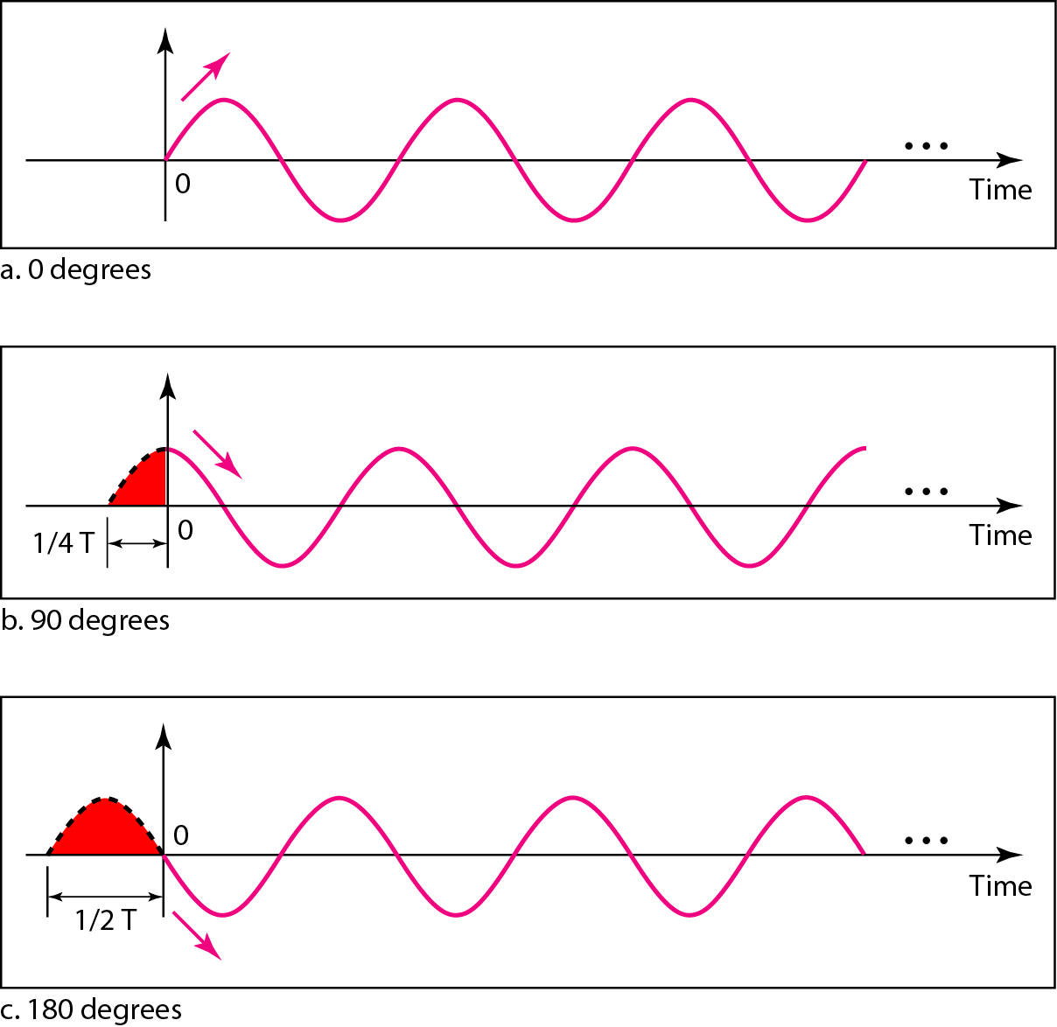
Three sine waves with the same amplitude and frequency, but different phases

Slide 20
Example
A sine wave is offset 1/6 cycle with respect to time 0. What is its phase in degrees and radians?
Solution
We know that 1 complete cycle is 360°. Therefore, 1/6 cycle is

Slide 21
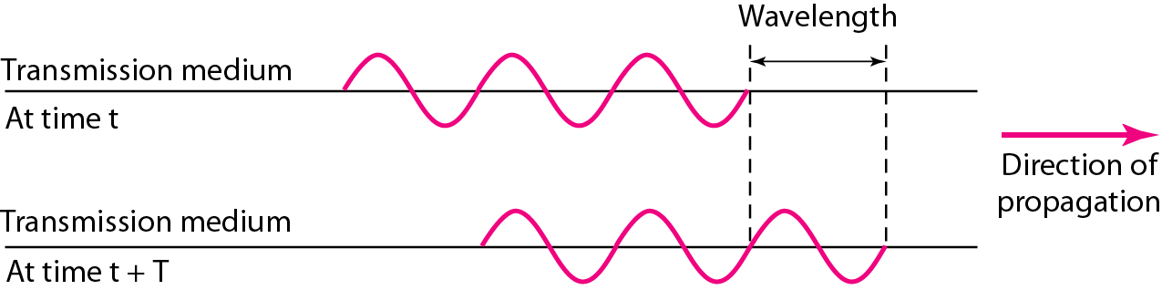
Wavelength and period
Wavelength : The distance between successive crests of a wave, especially points in a sound wave or electromagnetic wave.
Wavelength is usually measured in meters (m).

Slide 22
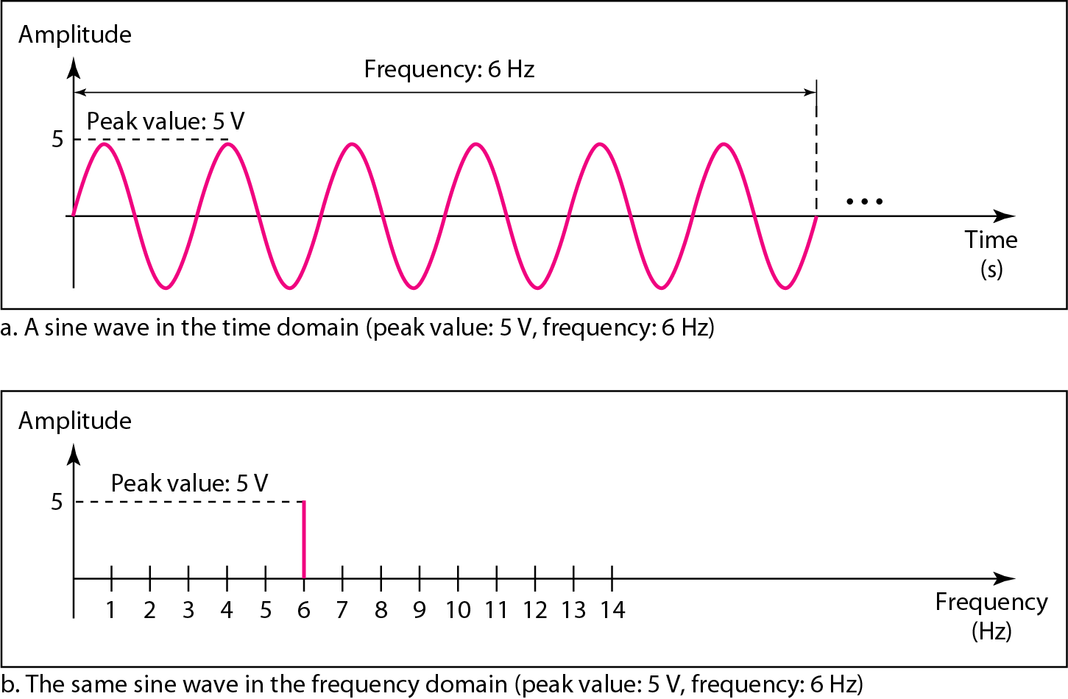
The time-domain and frequency-domain plots of a sine wave

Slide 23

Note
A complete sine wave in the time domain can be represented by one single spike in the frequency domain.

Slide 24
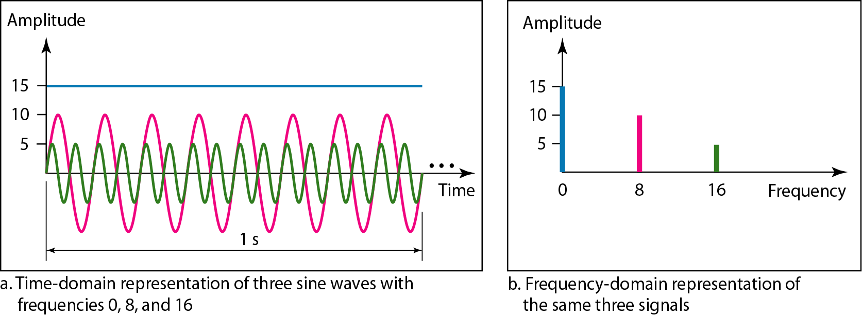
The time domain and frequency domain of three sine waves
The frequency domain is more compact and useful when we are dealing with more than one sine wave.
For example, three sine waves, each with different amplitude and frequency. All can be represented by three spikes in the frequency domain.

Slide 25
Signals and Communication
A single-frequency sine wave is not useful in data communications
We need to send a composite signal, a signal made of many simple sine waves.
According to Fourier analysis, any composite signal is a combination of simple sine waves with different frequencies, amplitudes, and phases.

Slide 26
Composite Signals and Periodicity
If the composite signal is periodic, the decomposition gives a series of signals with discrete frequencies.
If the composite signal is non-periodic, the decomposition gives a combination of sine waves with continuous frequencies.

Slide 27
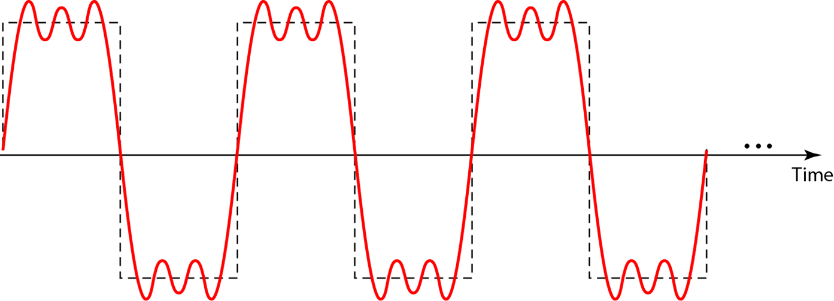
Example
periodic composite signal with frequency f
Not typical of those found in data communications.
We can consider it to be three alarm systems, each with a different frequency.
The analysis of this signal can give us a good understanding of how to decompose signals.

Slide 28
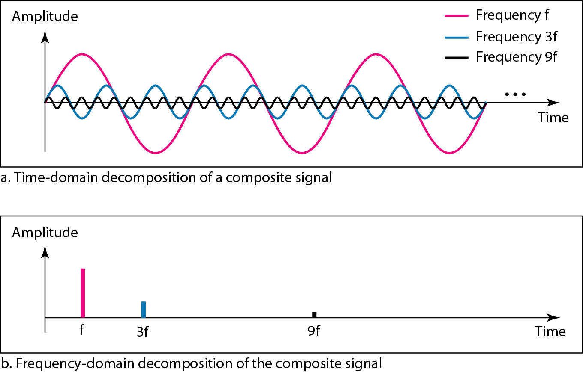
Decomposition of a composite periodic signal in the time and frequency domains

Slide 29
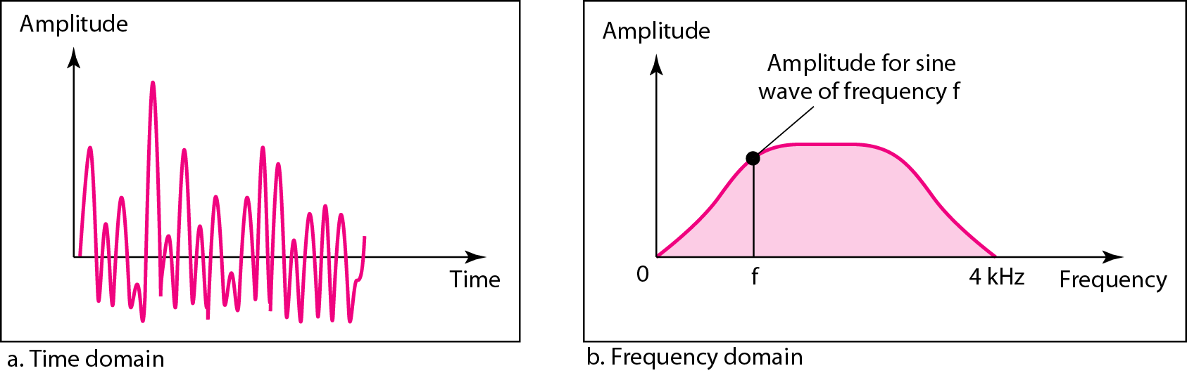
Example: a nonperiodic composite signal
The signal created by a microphone or a telephone set when a word or two is pronounced.
In this case, the composite signal cannot be periodic, because that implies that we are repeating the same word or words with exactly the same tone.

Slide 30
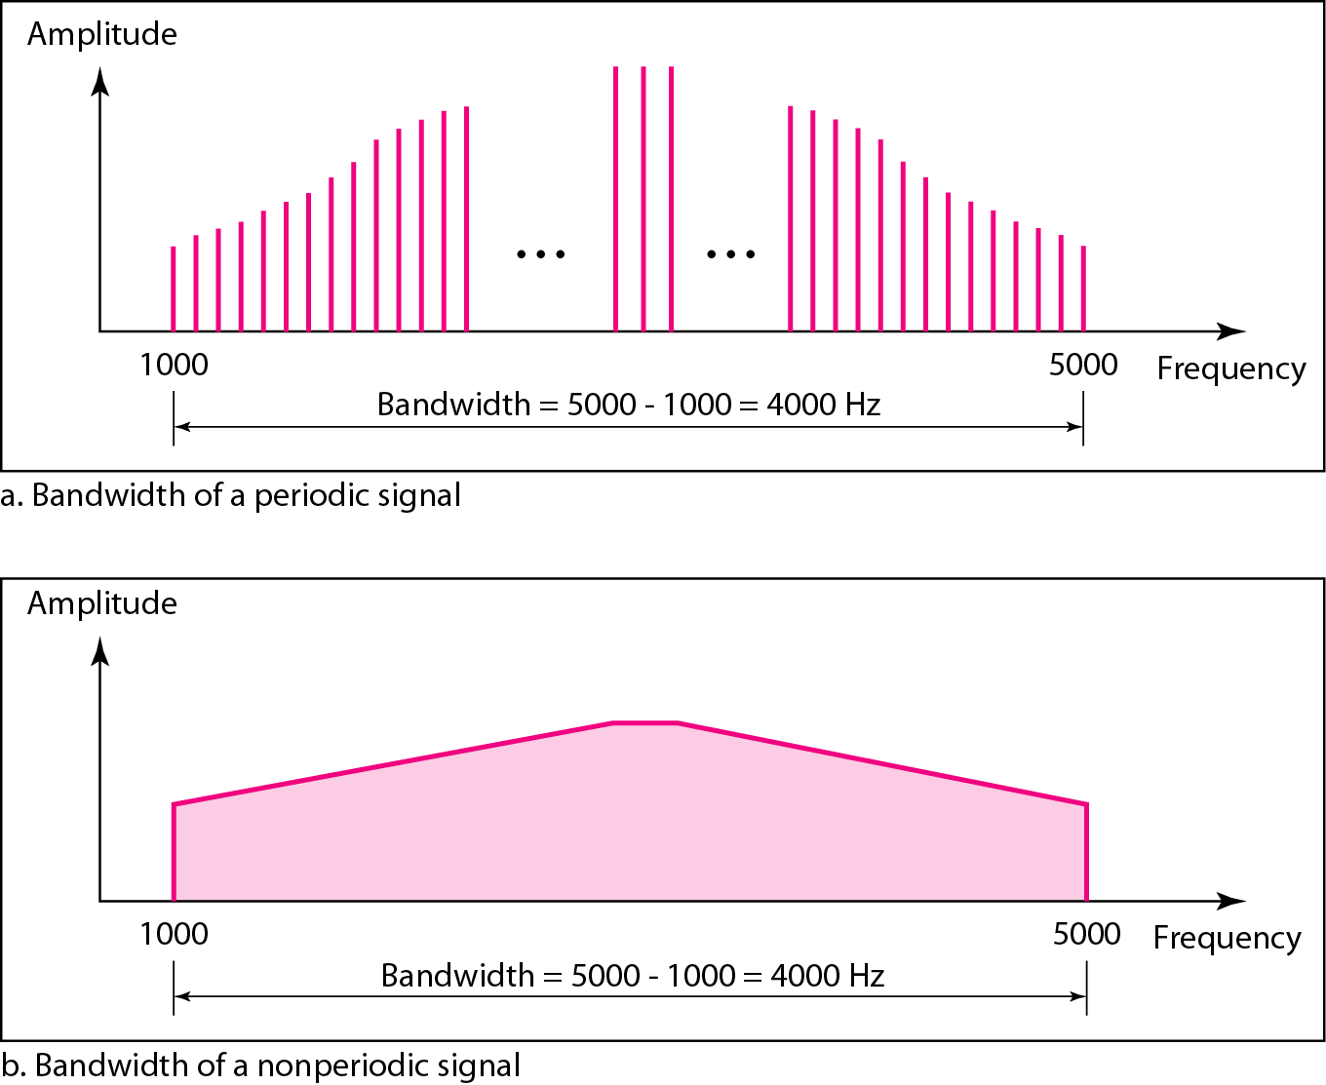
Bandwidth and Signal Frequency
The bandwidth of a composite signal is the difference between the highest and the lowest frequencies contained in that signal.
The bandwidth of periodic and
nonperiodic composite signals

Slide 31
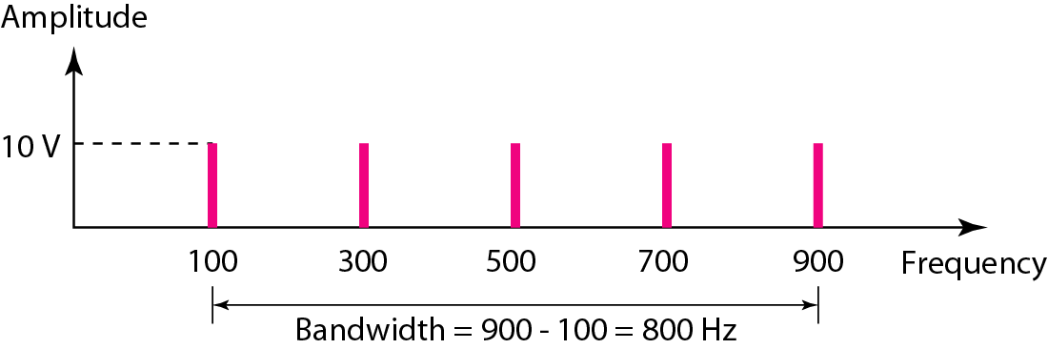
Example
If a periodic signal is decomposed into five sine waves with frequencies of 100, 300, 500, 700, and 900 Hz, what is its bandwidth? Draw the spectrum, assuming all components have a maximum amplitude of 10 V.
Solution
Let f_{h} be the highest frequency, f_{l} the lowest frequency, and B the bandwidth. Then
The spectrum has only five spikes, at 100, 300, 500, 700, and 900 Hz.

Slide 32
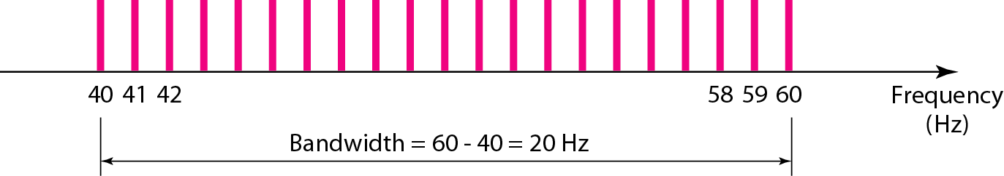
Example
A periodic signal has a bandwidth of 20 Hz. The highest frequency is 60 Hz. What is the lowest frequency? Draw the spectrum if the signal contains all frequencies of the same amplitude.
Solution
Let f_{h} be the highest frequency, f_{l} the lowest frequency, and B the bandwidth. Then
The spectrum contains all integer frequencies.

Slide 33
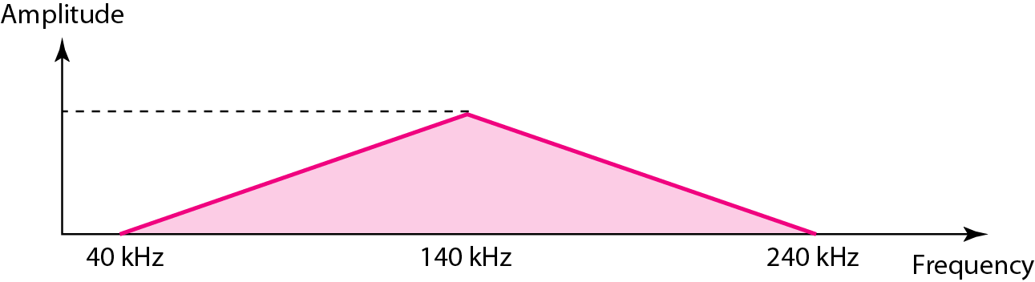
Example
A nonperiodic composite signal has a bandwidth of 200 kHz, with a middle frequency of 140 kHz and peak amplitude of 20 V. The two extreme frequencies have an amplitude of 0. Draw the frequency domain of the signal.
Solution
The lowest frequency must be at 40 kHz and the highest at 240 kHz.

Slide 34
Example
An example of a non-periodic composite signal is the signal propagated by an AM radio station. In the United States, each AM radio station is assigned a 10-kHz bandwidth. The total bandwidth dedicated to AM radio ranges from 530 to 1700 kHz.
Another example of a nonperiodic composite signal is the signal propagated by an FM radio station. In the United States, each FM radio station is assigned a 200-kHz bandwidth. The total bandwidth dedicated to FM radio ranges from 88 to 108 MHz.

Slide 35
Example
Another example of a nonperiodic composite signal is the signal received by an old-fashioned analog black-and-white TV. A TV screen is made up of pixels. If we assume a resolution of 525 × 700, we have 367,500 pixels per screen. If we scan the screen 30 times per second, this is 367,500 × 30 = 11,025,000 pixels per second. The worst-case scenario is alternating black and white pixels. We can send 2 pixels per cycle. Therefore, we need 11,025,000 / 2 = 5,512,500 cycles per second, or Hz.
The bandwidth needed is 5.5125 MHz.

Slide 36
DIGITAL SIGNALS

Slide 37
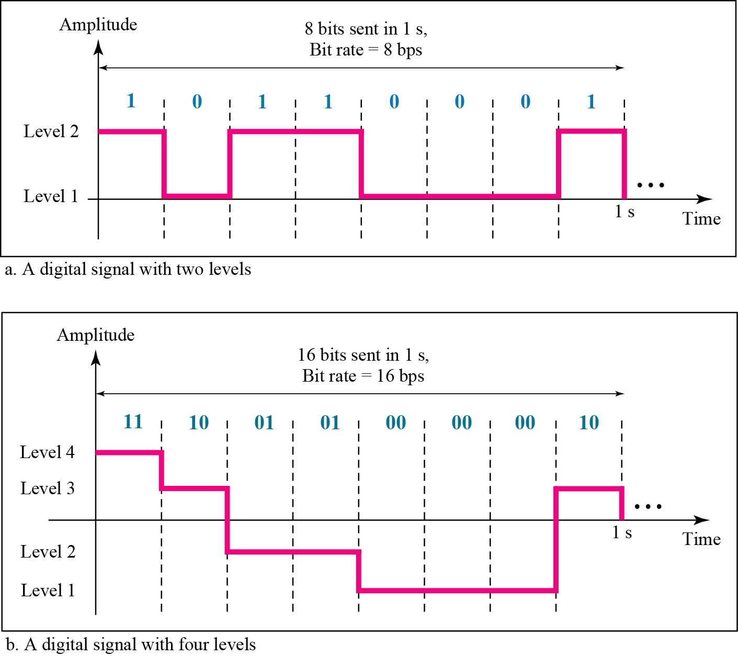

Two digital signals: one with two signal levels and the other with four signal levels

Slide 38
Example
A digital signal has eight levels. How many bits are needed per level? We calculate the number of bits from the formula
Each signal level is represented by 3 bits.

Slide 39
Bit rate : Number of bits sent in 1sec, bps
Assume we need to download text documents at the rate of 100 pages per sec. What is the required bit rate of the channel?
Solution
A page is an average of 24 lines with 80 characters in each line. If we assume that one character requires 8 bits (ascii), the bit rate is

Slide 40
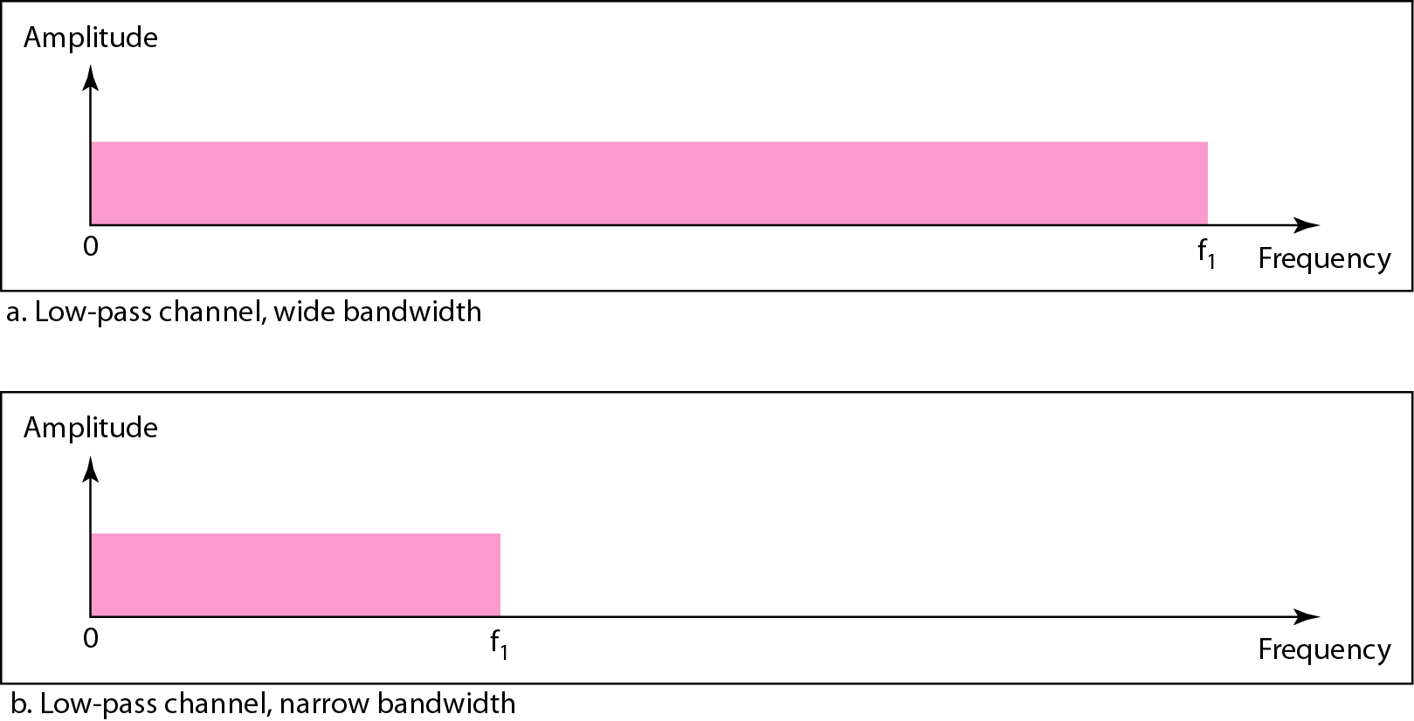
Bandwidths of two low-pass channels

Slide 41
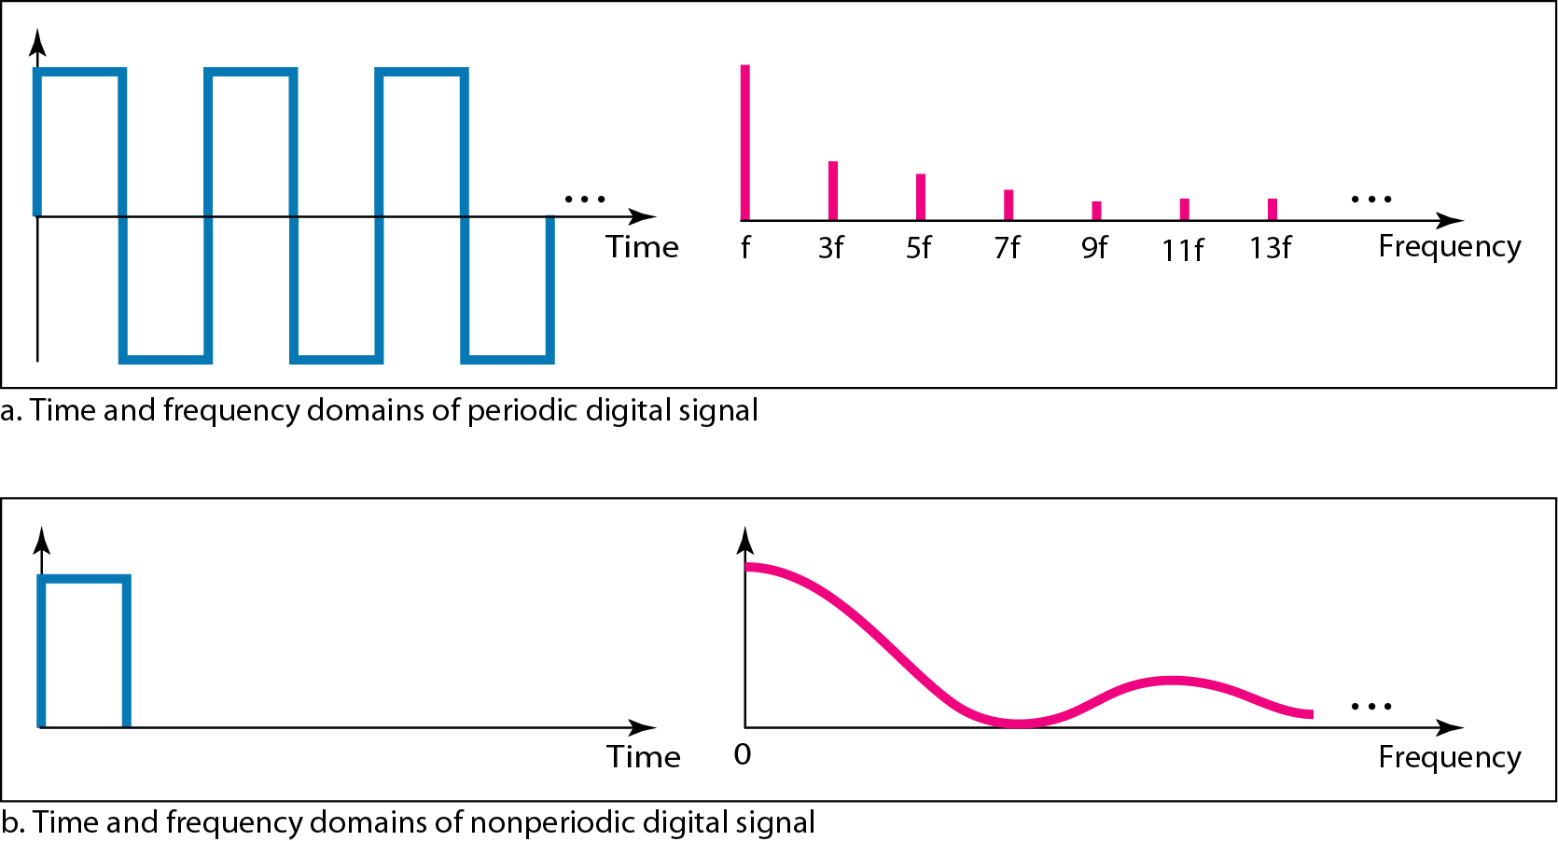
The time and frequency domains of periodic and nonperiodic digital signals

Slide 42
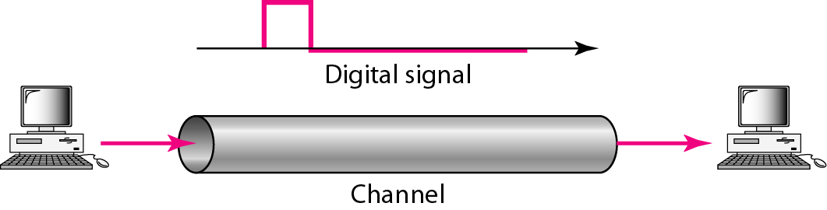
TRANSMISSION OF DIGITAL SIGNALS
Baseband transmission
A digital signal is a composite analog signal with an infinite bandwidth.

Slide 43
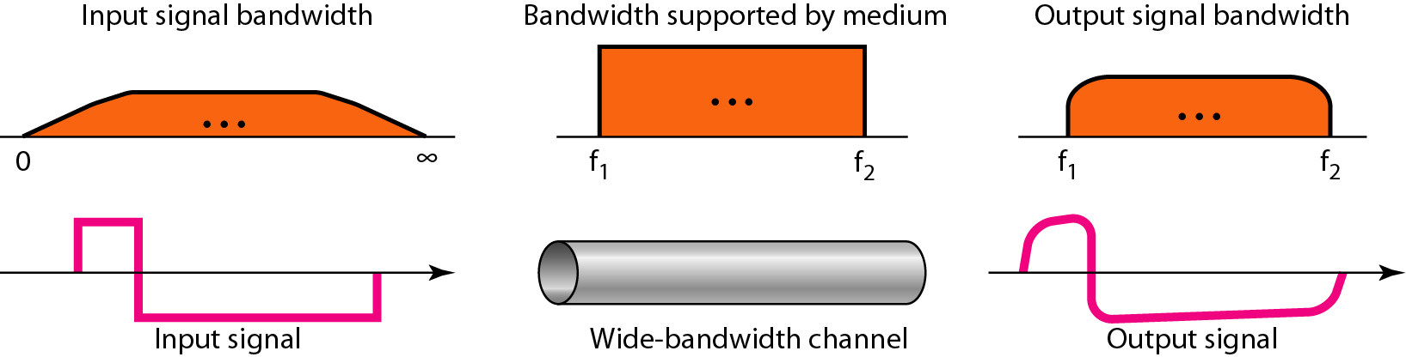
Baseband transmission using a dedicated medium

Slide 44
Note
Baseband transmission of a digital signal that preserves the shape of the digital signal is possible only if we have a low-pass channel with an infinite or very wide bandwidth.

Slide 45
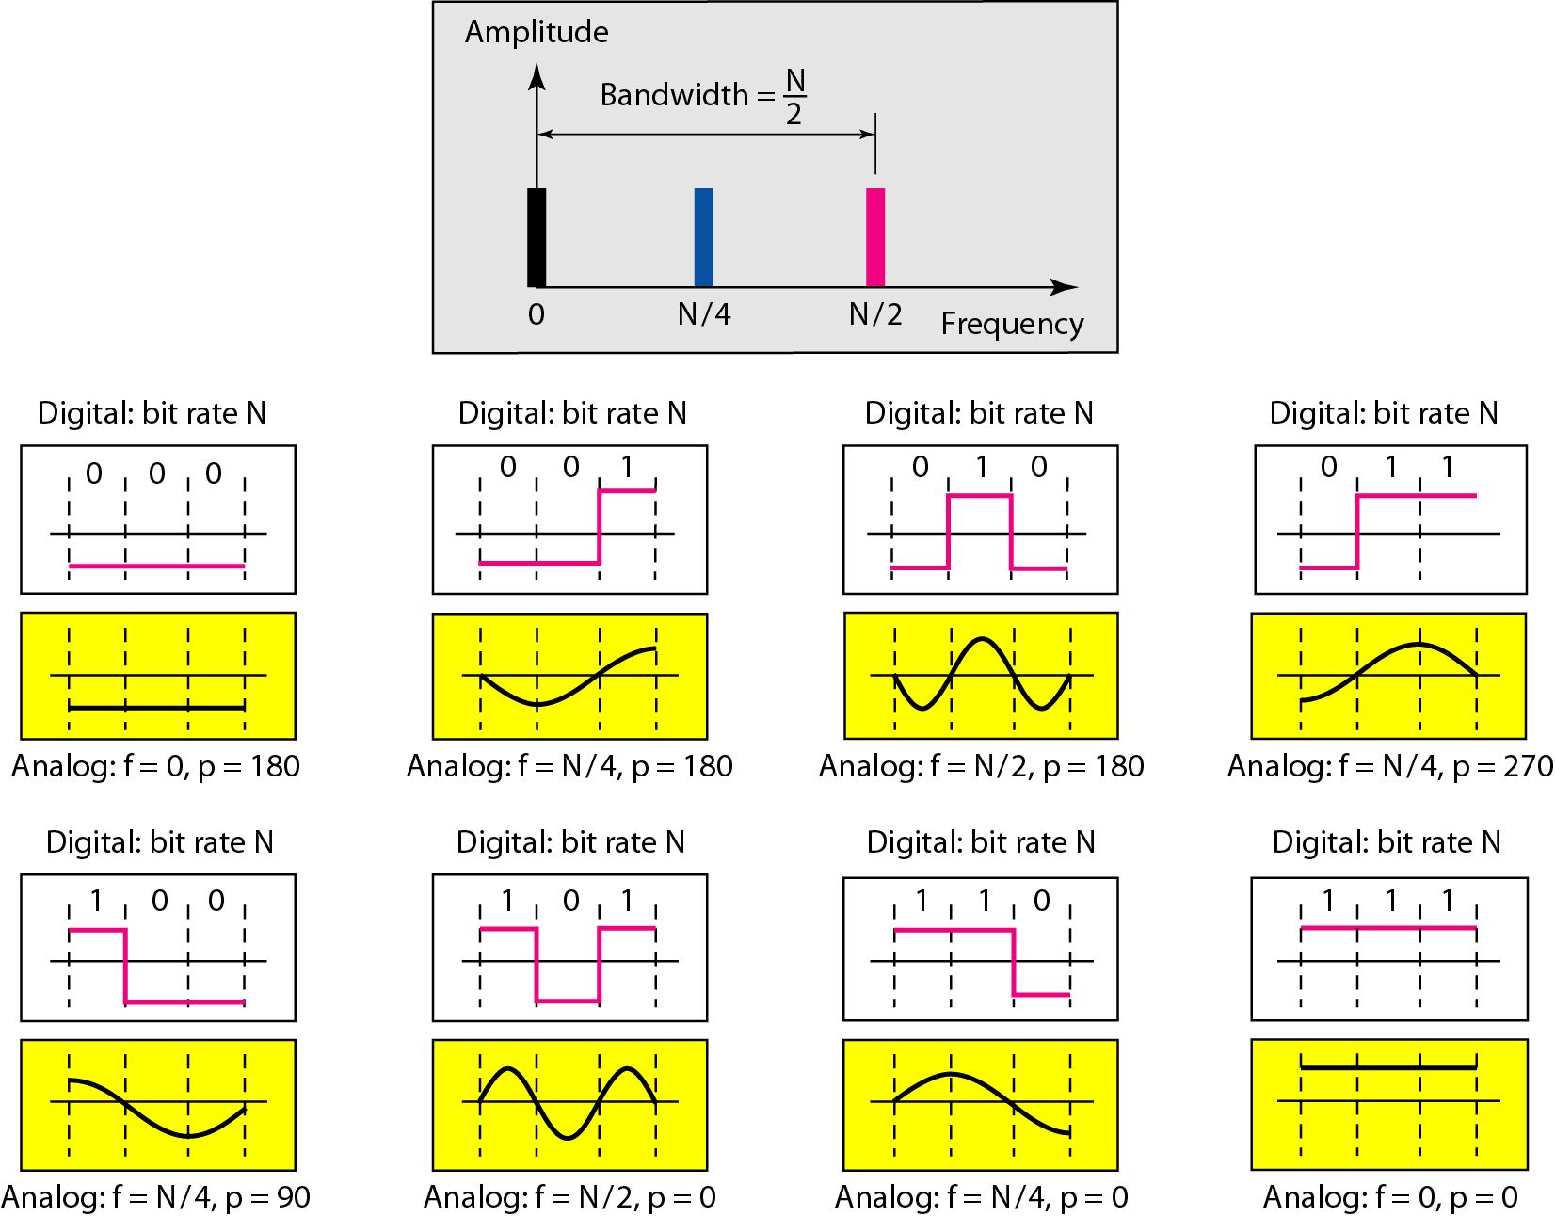
Rough approximation of a digital signal using the first harmonic for worst case

Slide 46
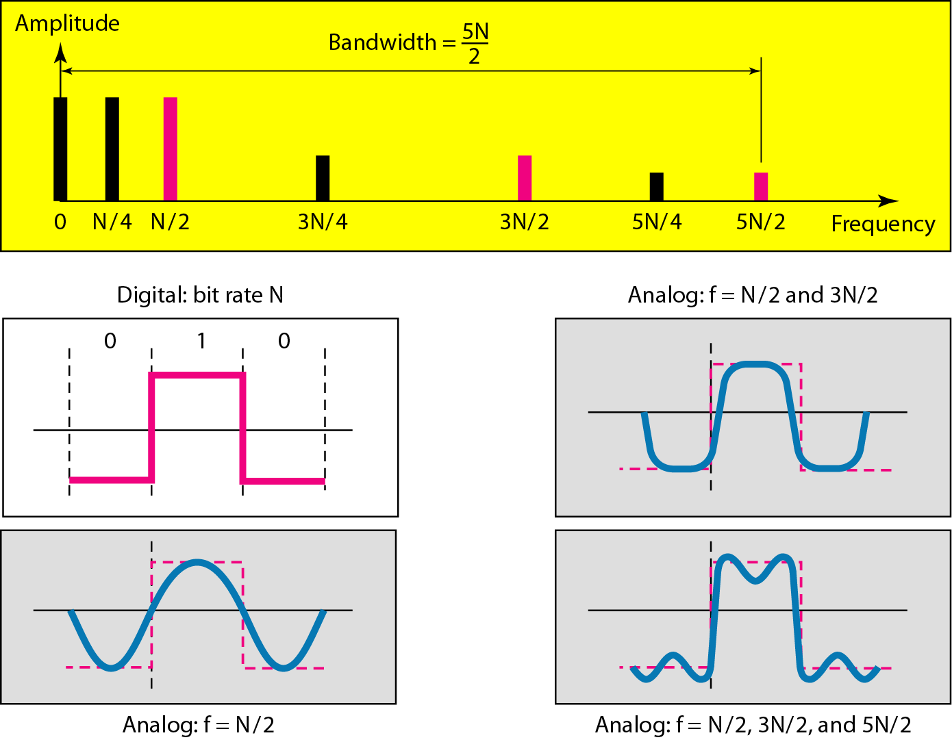
Simulating a digital signal with first three harmonics

Slide 47
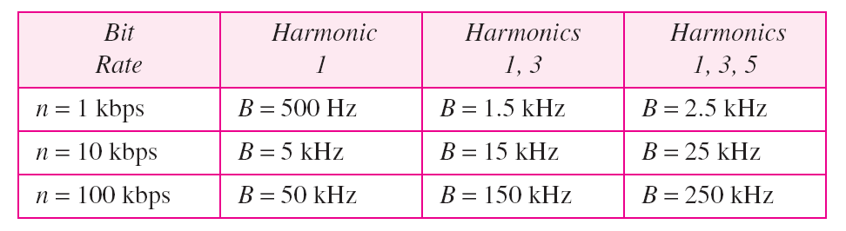
In baseband transmission, the required bandwidth is proportional to the bit rate;
if we need to send bits faster, we need more bandwidth.

Slide 48
What is the required bandwidth of a low-pass channel if we need to send 1 Mbps by using baseband transmission?
Solution
The answer depends on the accuracy desired.
a. The minimum bandwidth, is B = bit rate /2, or 500 kHz.
b. A better solution is to use the first and the third harmonics with B = 3 × 500 kHz = 1.5 MHz.
c. Still a better solution is to use the first, third, and fifth harmonics with B = 5 × 500 kHz = 2.5 MHz.

Slide 49
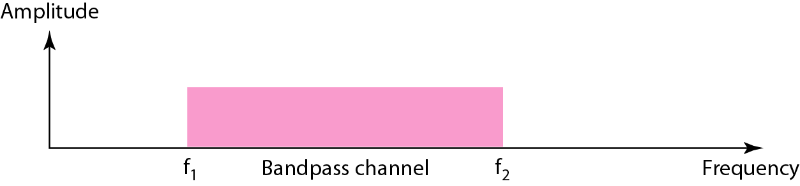
Bandwidth of a bandpass channel
If the available channel is a bandpass channel, we cannot send the digital signal directly to the channel; we need to convert the digital signal to an analog signal before transmission.

Slide 50
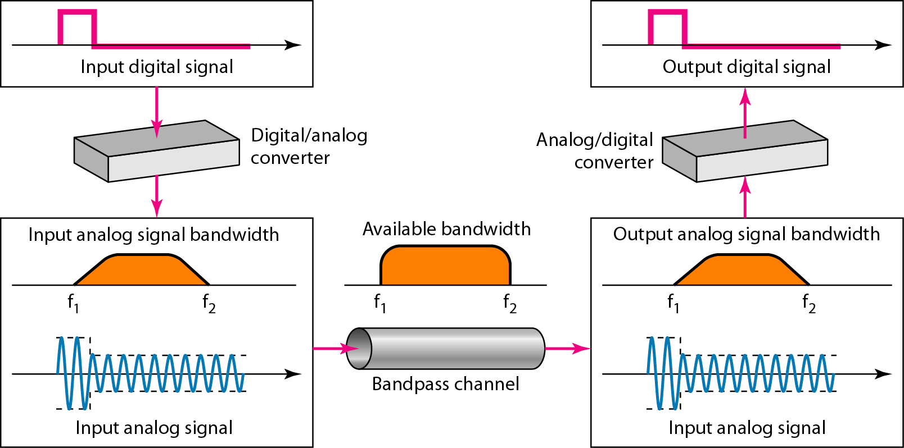
Modulation of a digital signal for transmission on a bandpass channel

Slide 51
Broadband transmission using modulation
sending of computer data through a telephone subscriber line,
lines are designed to carry voice with a limited bandwidth - bandpass channel.
Convert the digital signal from the computer to an analog signal, and send the analog signal.
install two converters to change the digital signal to analog and vice versa at the receiving end - modem
A second example is the digital cellular telephone.
digital cellular phones convert the analog voice signal to a digital signal
Although the bandwidth allocated to a company providing digital cellular phone service is very wide, we still cannot send the digital signal without conversion.
The reason is that we only have a bandpass channel available between caller and callee.
We need to convert the digitized voice to a composite analog signal before sending.

Slide 52
Fourier Analysis
Fourier analysis is a tool that changes a time domain signal to a frequency domain signal and vice versa.
The Fourier transform is a mathematical function that can be used to show the different frequency components of a continuous signal

Slide 53
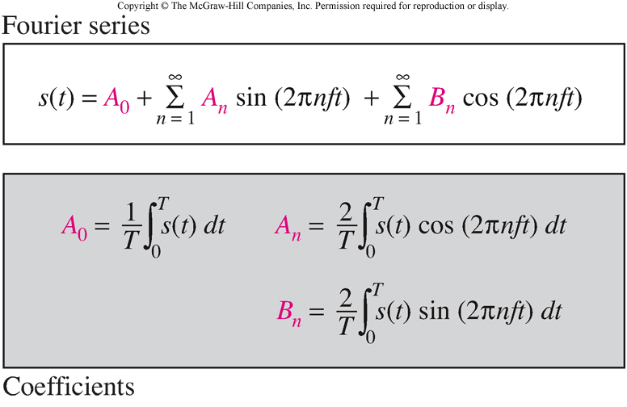
Fourier Series
Every composite periodic signal can be represented with a series of sine and cosine functions.
The functions are integral harmonics of the fundamental frequency “f” of the composite signal.
Using the series we can decompose any periodic signal into its harmonics.

Slide 54
Fourier Transform
Fourier Transform gives the frequency domain of a nonperiodic time domain signal.

Slide 55
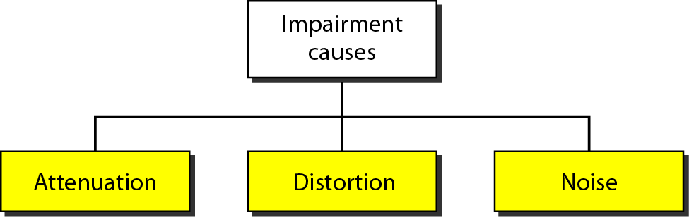
TRANSMISSION IMPAIRMENT
Signals travel through transmission media, which are not perfect. The imperfection causes signal impairment. This means that the signal at the beginning of the medium is not the same as the signal at the end of the medium. What is sent is not what is received.

Slide 56
Attenuation
Means loss of energy -> weaker signal
When a signal travels through a medium it loses energy overcoming the resistance of the medium
Amplifiers are used to compensate for this loss of energy by amplifying the signal.
To show the loss or gain of energy the unit “decibel” is used.
dB = 10log₁₀P₂/P₁
P₁ - input signal
P₂ - output signal
Example: a signal travels through a transmission medium and its power is reduced to one-half.

Slide 57
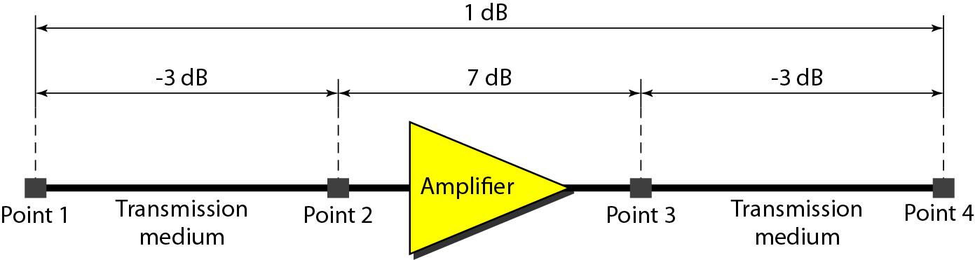

Slide 58
The loss in a cable is usually defined in decibels per kilometer (dB/km). If the signal at the beginning of a cable with −0.3 dB/km has a power of 2 mW, what is the power of the signal at 5 km?

Slide 59
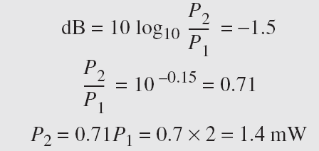
The loss in a cable is usually defined in decibels per kilometer (dB/km). If the signal at the beginning of a cable with −0.3 dB/km has a power of 2 mW, what is the power of the signal at 5 km?
Solution
The loss in the cable in decibels is 5 × (−0.3) = −1.5 dB. We can calculate the power as

Slide 60
Distortion
Means that the signal changes its form or shape
Distortion occurs in composite signals
Each frequency component has its own propagation speed traveling through a medium.
The different components therefore arrive with different delays at the receiver.
That means that the signals have different phases at the receiver than they did at the source.

Slide 61
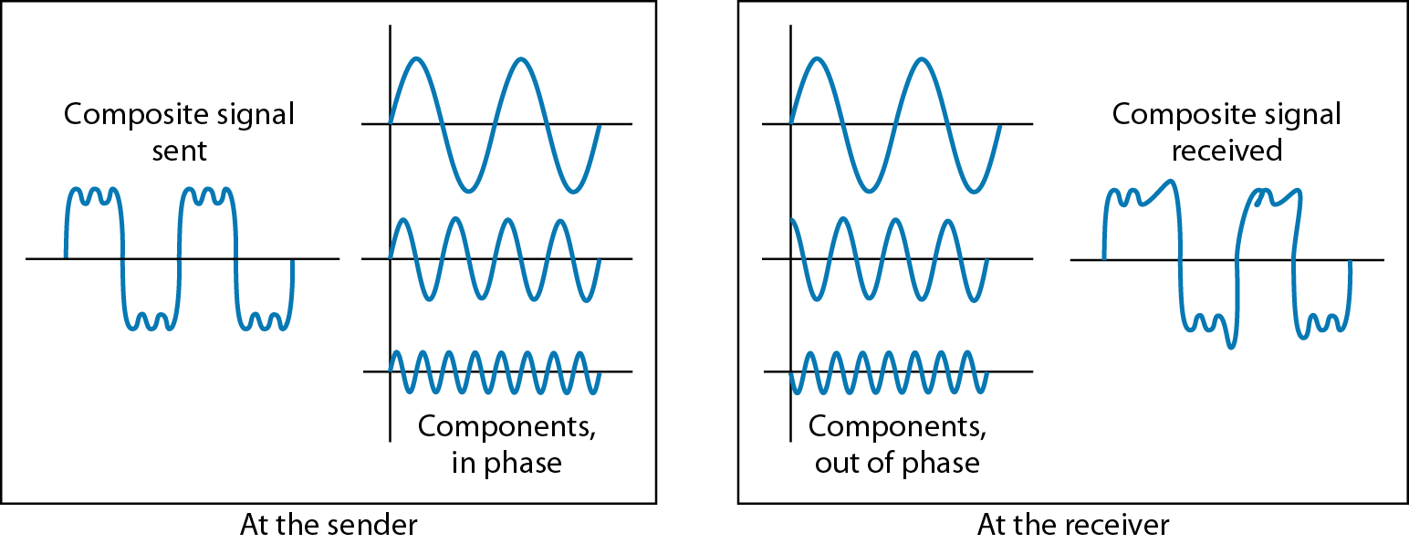
Distortion

Slide 62
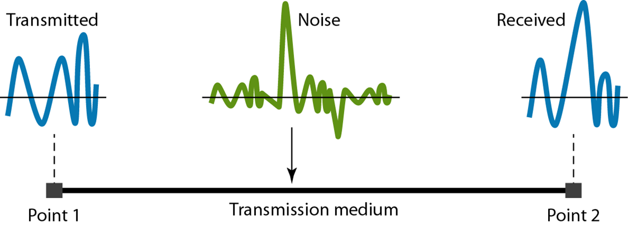
Noise
There are different types of noise
Thermal - random noise of electrons in the wire creates an extra signal
Induced - from motors and appliances, devices act are transmitter antenna and medium as receiving antenna.
Crosstalk - same as above but between two wires.
Impulse - Spikes that result from power lines, lightning, etc.

Slide 63
Signal to Noise Ratio (SNR)
To measure the quality of a system the SNR is often used. It indicates the strength of the signal wrt the noise power in the system.
It is the ratio between two powers.
It is usually given in dB and referred to as SNR_{dB.}

Slide 64
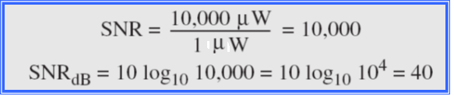
The power of a signal is 10 mW and the power of the noise is 1 μW; what are the values of SNR and SNR_{dB} ?
Solution
The values of SNR and SNRdB can be calculated as follows:

Slide 65
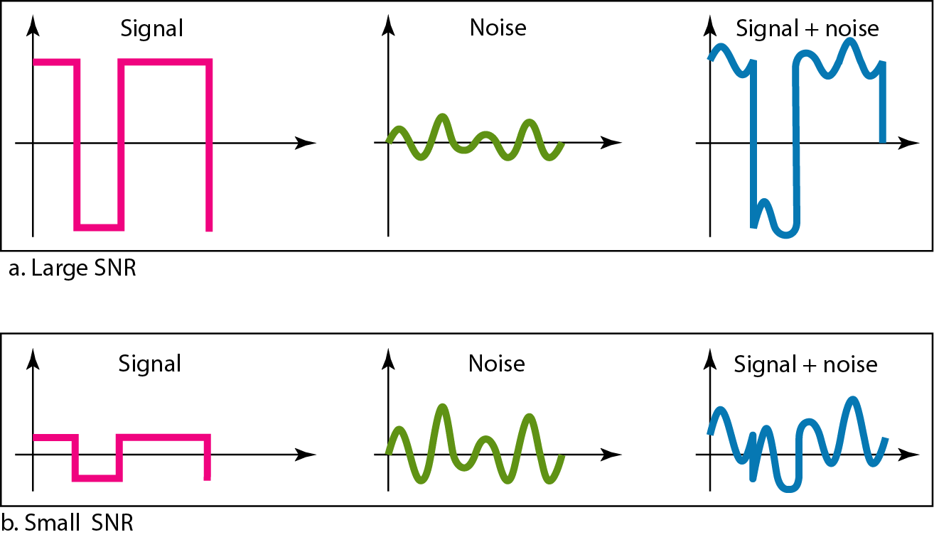
Two cases of SNR: a high SNR and a low SNR

Slide 66
DATA RATE LIMITS
A very important consideration in data communications is how fast we can send data, in bits per second, over a channel. Data rate depends on three factors:
1. The bandwidth available
2. The level of the signals we use
3. The quality of the channel (the level of noise)
Increasing the levels of a signal increases the probability of an error occurring

Slide 67
Capacity of a System
Bit rate α no. of signal levels
A symbol => a single bit or “n” bits.
The number of signal levels = 2^{n}.
As the number of levels goes up, the spacing between level decreases -> increasing the probability of an error occurring in the presence of transmission impairments.

Slide 68
Nyquist Theorem (Noisless Channel)
Nyquist theorem states that for a noiseless channel:
C = 2 B log₂2^{n}
C= capacity in bps
B = bandwidth in Hz
when we have only two levels, Nyquist theorem bit rate agree with the intuitive bit rate of baseband transmission
Maximum bit rate of a noiseless channel with a bandwidth of 3000 Hz transmitting a signal with two signal levels =

Slide 69
How many signal levels do we need to send 265 kbps over a noiseless channel with a bandwidth of 20 kHz.

Slide 70
Shannon’s Theorem(Noisy Channel)
Shannon’s theorem gives the capacity of a system in the presence of noise.
C = B log₂(1 + SNR)
When SNR ~0 =>
bit rate of a regular telephone line=>

Slide 71
We can calculate the theoretical highest bit rate of a regular telephone line. A telephone line normally has a bandwidth of 3000. The signal-to-noise ratio is usually 3162. For this channel the capacity is calculated as
This means that the highest bit rate for a telephone line is 34.860 kbps. If we want to send data faster than this, we can either increase the bandwidth of the line or improve the signal-to-noise ratio.

Slide 72
The signal-to-noise ratio is often given in decibels. Assume that SNR_{dB} = 36 and the channel bandwidth is 2 MHz. The theoretical channel capacity can be calculated as

Slide 73


For practical purposes, when the SNR is very high, we can assume that SNR + 1 is almost the same as SNR. In these cases, the theoretical channel capacity can be simplified to
For example, we can calculate the theoretical capacity of the previous example as

Slide 74
We have a channel with a 1-MHz bandwidth. The SNR for this channel is 63. What are the appropriate bit rate and signal level?
Solution
First, we use the Shannon formula to find the upper limit.

Slide 75
Example 3.41 (continued)
The Shannon formula gives us 6 Mbps, the upper limit. For better performance we choose something lower, 4 Mbps, for example. Then we use the Nyquist formula to find the number of signal levels.

Slide 76
Note
The Shannon capacity gives us the upper limit; the Nyquist formula tells us how many signal levels we need.

Slide 77
3-6 PERFORMANCE
One important issue in networking is the performance of the network—how good is it?
Bandwidth - capacity of the system
Throughput - no. of bits that can be pushed through
Latency (Delay) - delay incurred by a bit from start to finish
Bandwidth-Delay Product

Slide 78
In networking, we use the term bandwidth in two contexts.
The first, bandwidth in hertz, refers to the range of frequencies in a composite signal or the range of frequencies that a channel can pass.(analog devices)
The second, bandwidth in bits per second, refers to the speed of bit transmission in a channel or link. Often referred to as Capacity. (digital devices)
The bandwidth of a subscriber line is 4 kHz for voice or data. The bandwidth of this line for data transmission can be up to 56,000 bps using a sophisticated modem to change the digital signal to analog.

Slide 79

THROUGHPUT
Throughput is the number of messages successfully transmitted per unit time.
Controlled by available bandwidth, the available signal-to-noise ratio and hardware limitations.
A network with bandwidth of 10 Mbps can pass only an average of 12,000 frames per minute with each frame carrying an average of 10,000 bits. What is the throughput of this network?
The throughput is almost one-fifth of the bandwidth in this case.

Slide 80
LATENCY (DELAY)
total time taken for a complete message to arrive at the destination, starting with the time when the first bit of the message is sent out from the source and ending with the time when the last bit of the message is delivered at the destination.
latency may be defined as the time required to successfully send a packet across a network.
Latency = Propagation Time + Transmission Time + Queuing Time + Processing Delay

Slide 81
Propagation & Transmission delay
Propagation speed - speed at which a bit travels though the medium from source to destination.
Transmission speed - the speed at which all the bits in a message arrive at the destination. (difference in arrival time of first and last bit)
Propagation time = Distance / Propagation speed
Transmission time = Message size / Bandwidth

Slide 82
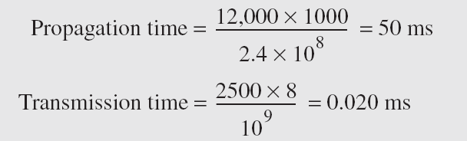
What are the propagation time and the transmission time for a 2.5-kbyte message (an e-mail) if the bandwidth of the network is 1 Gbps? Assume that the distance between the sender and the receiver is 12,000 km and that light travels at 2.4 × 108 m/s.
Solution:

Slide 83
Queuing Time: Queuing time is a time based on how long the packet has to sit around in the router.
Processing Delay: Processing delay is the delay based on how long it takes the router to figure out where to send the packet
BANDWIDTH – DELAY PRODUCT Bandwidth and delay are two performance measurements of a link.
The bandwidth-delay product defines the number of bits that can fill the link.

Slide 84
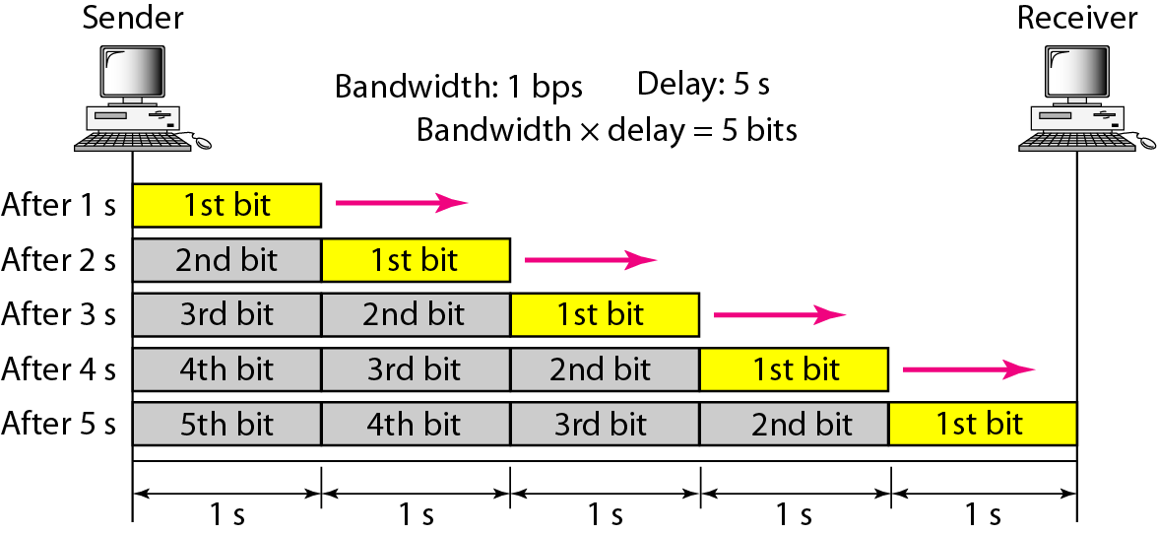
Case 1: Assume a link is of bandwidth 1bps and the delay of the link is 5s.

Slide 85
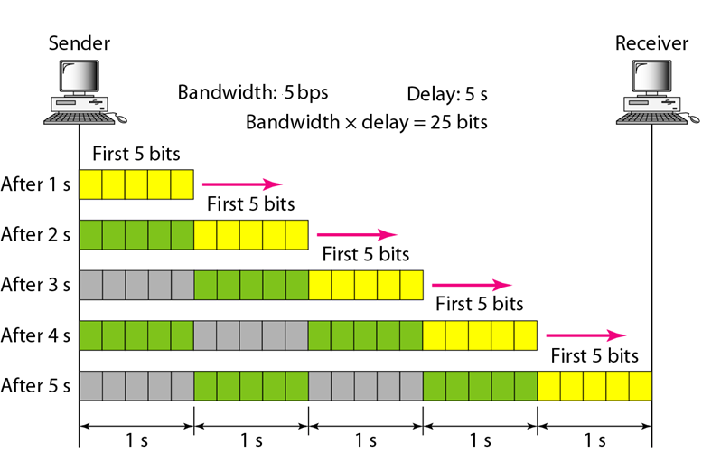
Case 2: Assume a link is of bandwidth 5bps

Slide 86
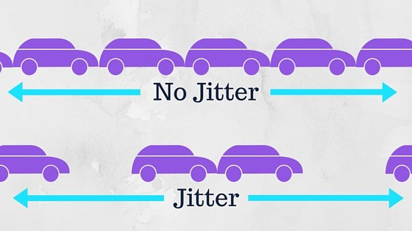
JITTER
Jitter is a “packet delay variance”.
It can simply mean that jitter is considered as a problem when different packets of data face different delays in a network and the data at the receiver application is time-sensitive, i.e. audio or video data.
Jitter is measured in milliseconds(ms)
The major causes of jitter are electromagnetic interference(EMI) and crosstalk between signals.

